Slide 1
DAILY ROUTINE BETTY CAROLINA CARDONA CASTAEDA English
Harold Yulian sanchez alcantar
Programación de software
2671339

Slide 2




Slide 3
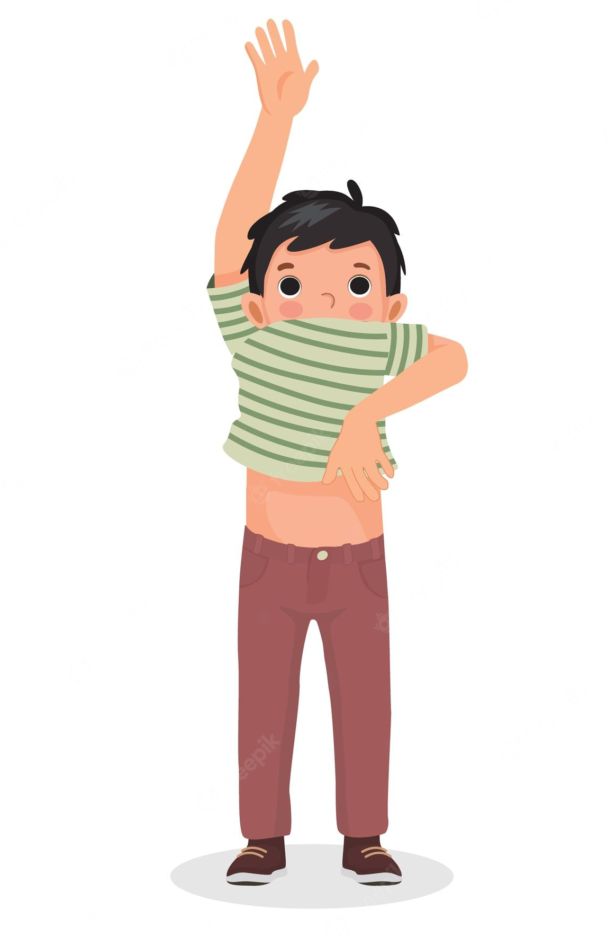


Slide 4
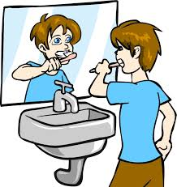


Slide 5

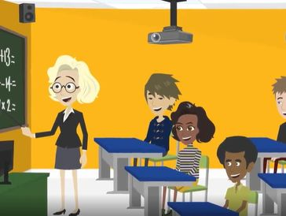

Slide 6



